Slide 1
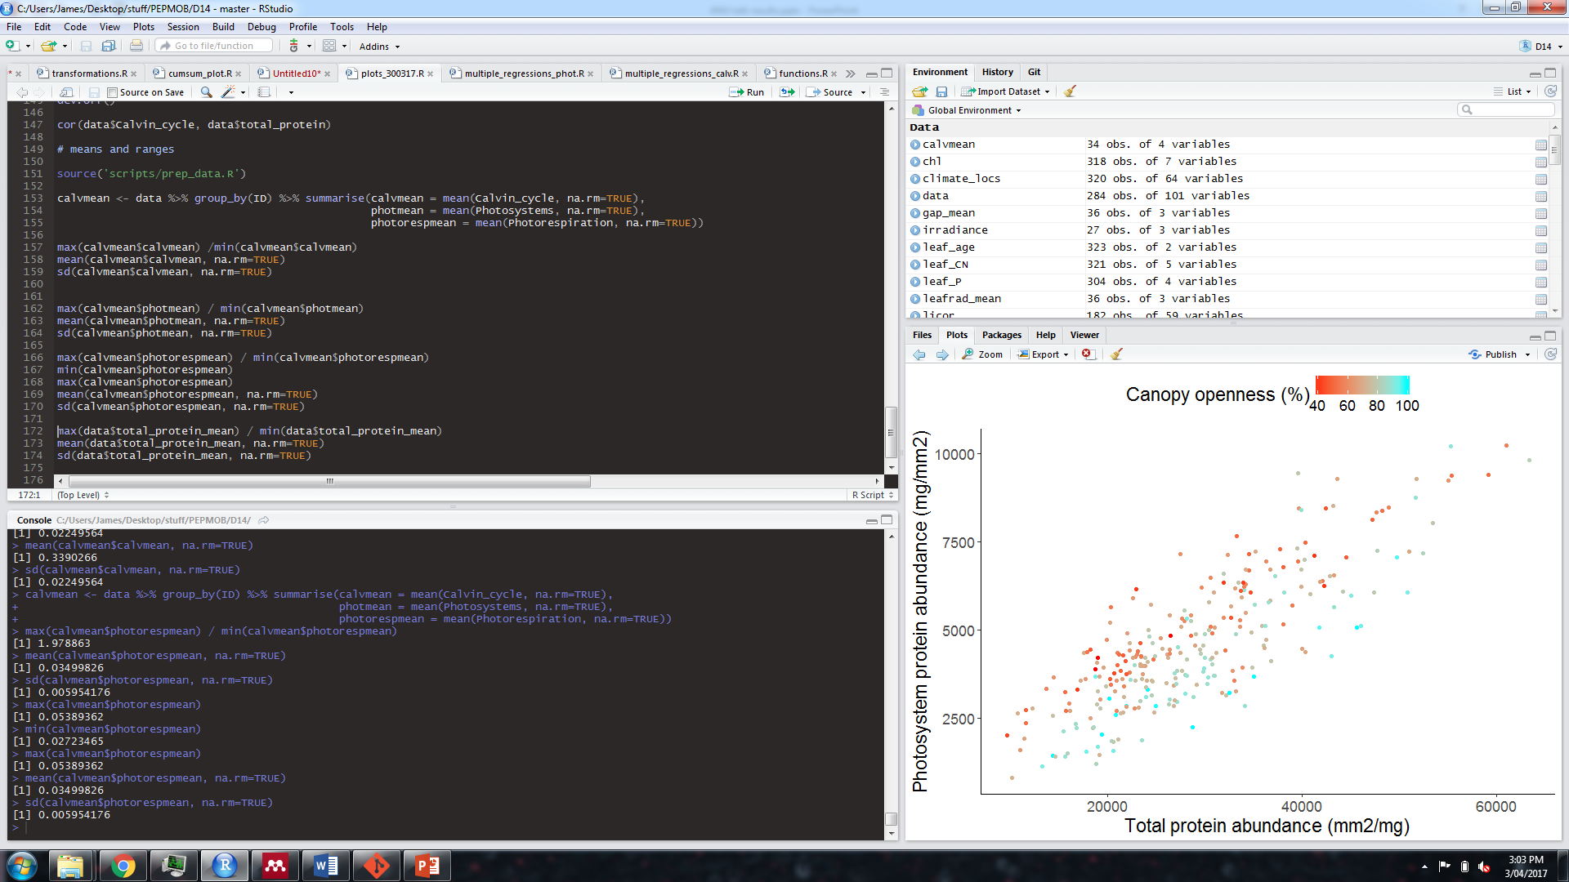
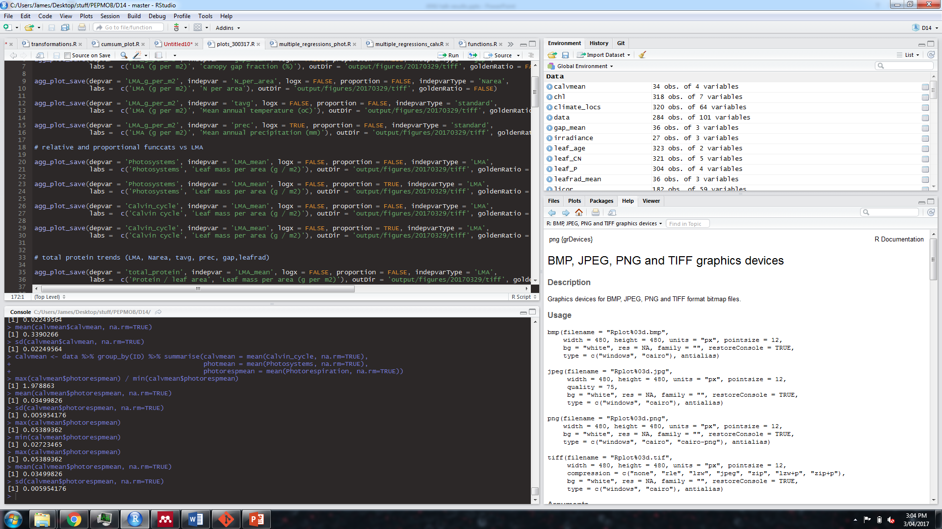
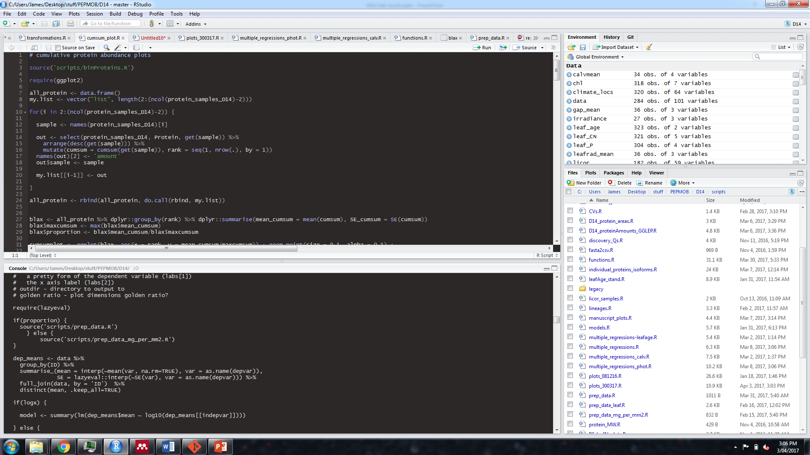
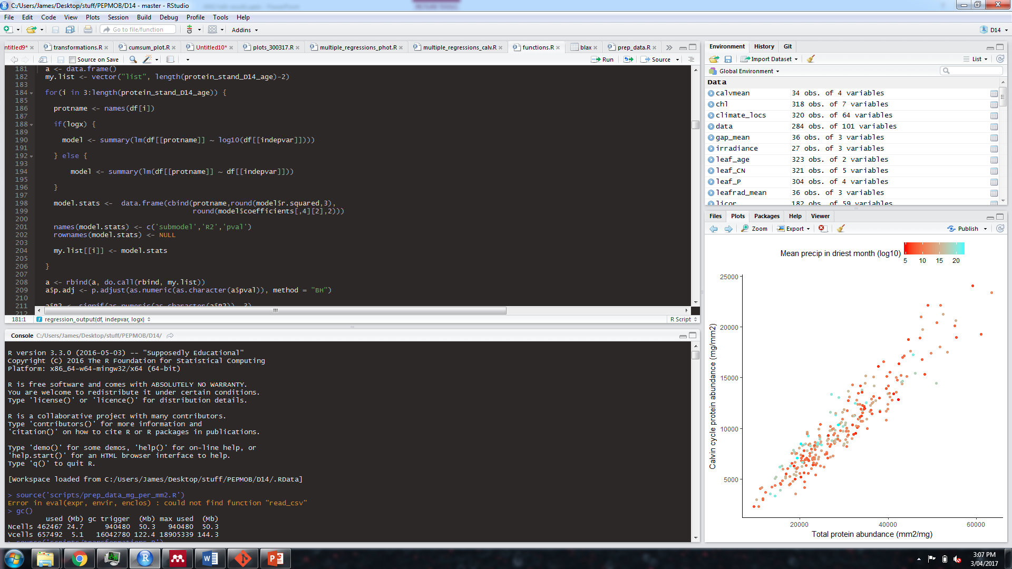

Slide 2
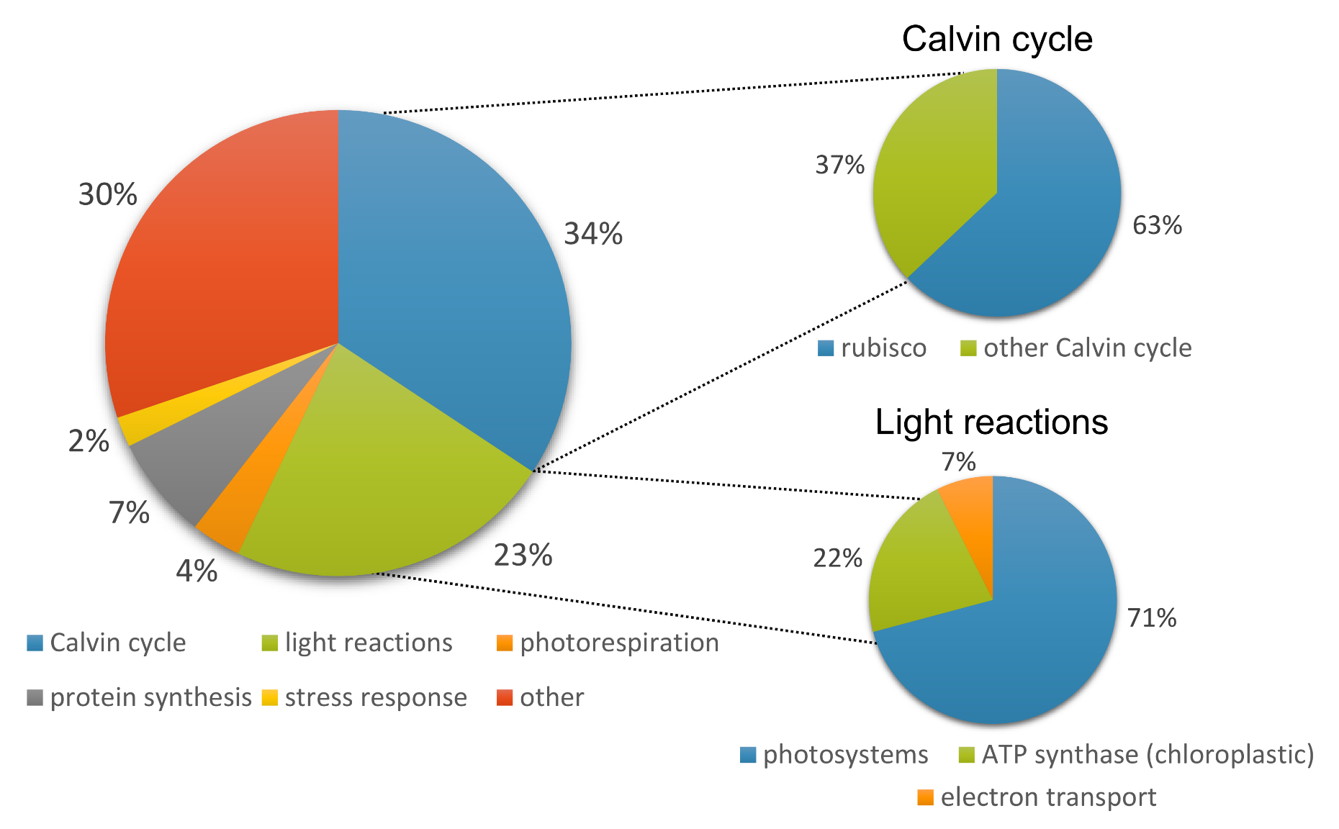
What’s in a leaf?
Leaf protein content ranges between 3 - 39 % of leaf dry mass (mean = 12 %, stdev = 4 %)
Notes:
Around 60% of the protein in our euc leaves was accounted for by photosynthesis proteins.
The mean abundances of the different functional categories shift around – as different samples have different proportions of protein within a given functional category at a given rank.
There are some gaps in the data here because of the cumulative summing code I used – it finds the average proportion of total protein for a given rank, and if there aren’t any proteins from that rank for a particular functional category then there’s a gap. Or just a point if there was just one sample with a protein at that rank.
The categories that have super abundant proteins – that would be Rubisco in the Calvin cycle and ATP synthase – start off being the most abundant but are gradually replaced as we increase the number of proteins.

Slide 3
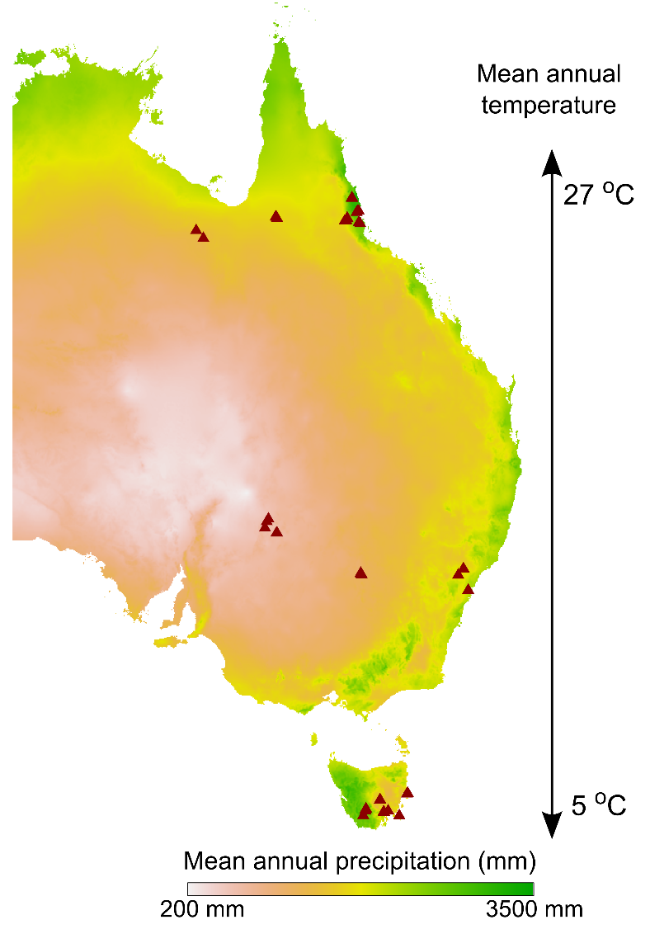
Optimising the photosynthetic apparatus
Co-ordination hypothesis: leaves should optimise protein allocation so that photosynthesis is co-limited by light capture and carboxylation capacity
Protein allocation to photosystems should:
Decrease with increasing light
Protein allocation to Calvin cycle should:
Increase with increasing light
Decrease with increasing water availability

Slide 4
Allocation to photosystems is greater in low light
p < 0.001, R² = 0.43, 54 % decline
p < 0.001, R² = 0.37, 42 % decline
Canopy openness (%)
Irradiance (MJ/m²/yr)
 | Min. | Max. | Mean | Std. dev. | Magnitude
Photosystems (proportion) | 0.09 | 0.23 | 0.16 | 0.03 | 2.5-fold
Notes:
Disentangling precip effect – if you look at precip over just the last year, there’s a much weaker correlation. Could mean that we’re really interested in time averaged effect on vegetation structure and light evnrio

Slide 5

Allocation to photosystems is greater in low light
p < 0.001, R² = 0.43, 54 % decline
p < 0.001, R² = 0.37, 42 % decline
Canopy openness (%)
Irradiance (MJ/m²/yr)
 | Min. | Max. | Mean | Std. dev. | Magnitude
Photosystems (proportion) | 0.09 | 0.23 | 0.16 | 0.03 | 2.5-fold
Notes:
Disentangling precip effect – if you look at precip over just the last year, there’s a much weaker correlation. Could mean that we’re really interested in time averaged effect on vegetation structure and light evnrio

Slide 6
Trends in proportional abundance of Calvin cycle proteins
p = 0.19
p =0.02, R² = 0.16, 8 % increase
p = 0.07
Canopy openness (%)
Irradiance (MJ/m²/yr)
Precipitation (mm/yr)
 | Min. | Max. | Mean | Std. dev. | Magnitude
Calvin cycle (proportion) | 0.29 | 0.38 | 0.339 | 0.023 | 1.3-fold

Slide 7
Environmental trends in abundance of Calvin cycle proteins
p = 0.19
p =0.02, R² = 0.16, 8 % increase
p = 0.07
Canopy openness (%)
Irradiance (MJ/m²/yr)
Precipitation (mm/yr)
 | Min. | Max. | Mean | Std. dev. | Magnitude
Calvin cycle (proportion) | 0.29 | 0.38 | 0.339 | 0.023 | 1.3-fold

Slide 8
Room to move? Variation in proportional allocation
r = 0.82
r = 0.95
 | Min. | Max. | Mean | Std. dev. | Magnitude
Photosystems (proportion) | 0.09 | 0.23 | 0.16 | 0.03 | 2.5-fold
Calvin cycle (proportion) | 0.29 | 0.38 | 0.339 | 0.023 | 1.3-fold
Notes:
Photosystem abundance tracks total protein abundance less tightly than Calvin cycle abundance does. Leaves have more scope to alter proportional investment in photosystem proteins than Calvin cycle proteins.
Optimisation of carboxylation capacity more likely to be achieved by altering total leaf protein. One way to do this is by changing leaf mass per area

Slide 9
Influence of leaf anatomy on protein abundance
Calvin cycle
Photosystems
p = 0.88
p = 0.01, R² = 0.20
p < 0.001, R² = 0.31
p < 0.001, R² = 0.26
p = 0.15
Notes:
Leaves don’t produce more photosystem proteins as they become thicker, but they do produce more Calvin cycle proteins (and pretty much every other category of protein). Suggests that carboxylation capacity is added by leaf thickening but there is no effect on light capture.

Slide 10
Environmental trends in leaf mass per area
p = 0.01, R² = 0.19
p < 0.001, R² = 0.21
Canopy openness (%)
Precipitation (mm/yr)

Slide 11
Environmental trends in leaf mass per area
p = 0.01, R² = 0.19
p < 0.001, R² = 0.21
Canopy openness (%)
Precipitation (mm/yr)

Slide 12
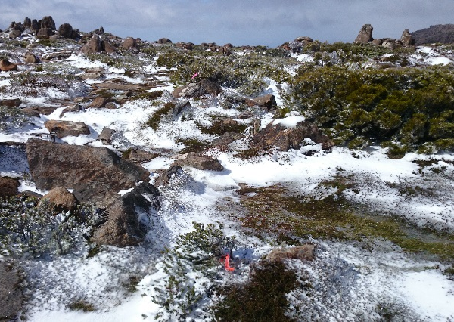
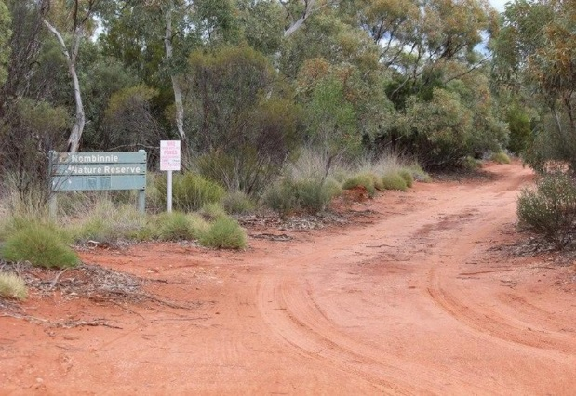
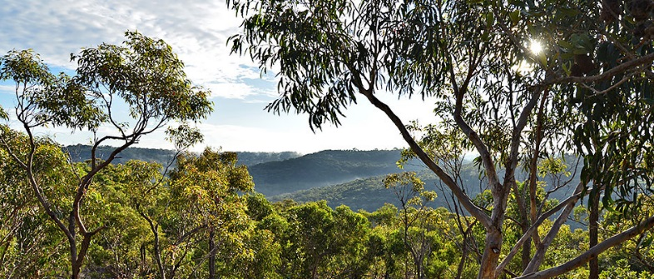
Summary
The bulk of leaf protein is associated with photosynthesis
Leaves adjust proportional protein allocation to photosystem proteins in response to light availability
Environmental factors have only a marginal influence on proportional abundance of Calvin cycle proteins
Optimisation of carboxylation capacity is likely achieved by altering leaf anatomy and the total amount of protein per leaf area

Slide 13
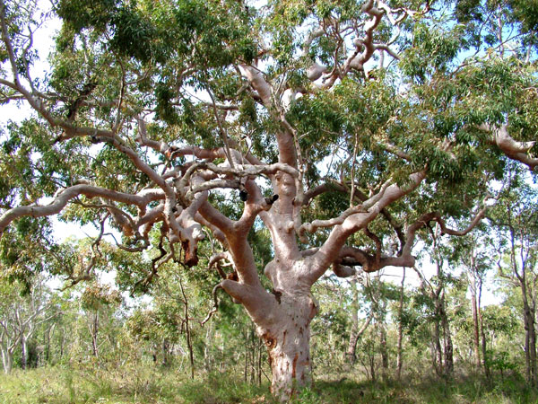
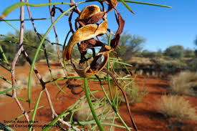
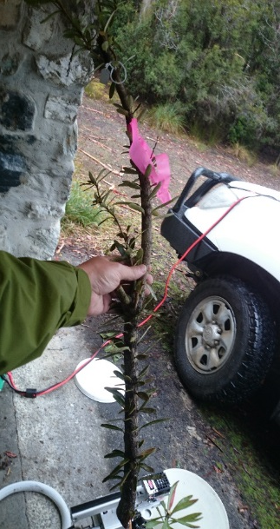
Where to next?
Comparative work using data from Acacia and the Proteaceae
Responses of other protein functional groups across environmental gradients
Parameterising systems-level models of photosynthesis and earth system models

Slide 14

Participants
Dr Lara Ainley
Ms Katy Breakwell
Ms Jennalee Clark
Dr Tory Clarke
Ms Michelle Demers
Dr Siobhan Dennison
Dr James Lawson
Dr Renée Marchin
Dr Steve Van Sluyter
Ms Leslie Ward
Prof Mark Westoby
Acknowledgements
Dr Mike Aspinwall, Profs Belinda Medlyn and David Tissue, Hawkesbury Institute for the Environment
Mr Chris Hodgkins, Sciex
Dr Adam Carroll, ANU
Dr Ben Crossett, University of Sydney
Funding
SIEF John Stocker Postdoctoral Fellowship
ARC Discovery Project

Slide 16
Effect of temperature on Cytochrome b6f (electron transport)
p < 0.001, R² = 0.35

Slide 17
Correlation matrix of environmental variables
 | Canopy openness | Irradiance | Mean annual temp. | Mean annual precip.
Canopy openness | 1 | 0.85 | 0.2 | 0.55
Irradiance | 0.85 | 1 | 0.61 | -0.5
Mean annual temp. | 0.2 | 0.61 | 1 | 0.16
Mean annual precip. | -0.55 | -0.5 | 0.16 | 1

Slide 18
